Slide 1
Diagnostics of electron beams and plasma wave in laser-plasma accelerators
Laszlo Veisz¹, Alexander Buck^{1,2}, Maria Nicolai³, Karl Schmid¹, Chris M. S. Sears¹,
Alexander Sävert³, Julia M. Mikhailova¹, Malte C. Kaluza^{3,4}, and Ferenc Krausz^{1,2}
¹ Max-Planck-Institut für Quantenoptik, Hans-Kopfermann-Strasse 1, 85748 Garching, Germany
² Ludwig-Maximilians-Universität München, Am Coulombwall 1, 85748 Garching, Germany
³ Institut für Optik und Quantenelektronik, Friedrich-Schiller-Universität, 07743 Jena, Germany
⁴ Helmholtz-Institute Jena, Helmholtzweg 4, 07743 Jena, Germany
Notes:
1

Slide 2
Outline
Introduction
Observation of accelerating structure – plasma waves
Temporal characterization of electron bunches
Direct temporal observation of laser wakefield acceleration
Shock-front injection and its temporal characterization
Summary and conclusions

Slide 3
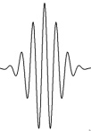
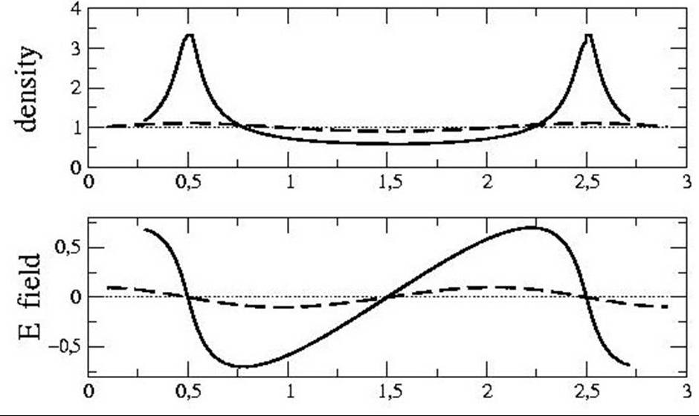
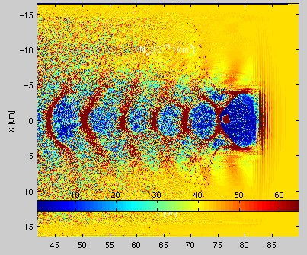
Characteristics of
electron bunch and plasma wave
The accelerating structure −
Important plasma wave properties:
Plasma period / wavelength (~few-10 μm)
Total length (single/ multiple cycles)
Electron bunch position(s)
Amplitude
Accelerating field
Accelerated electron beam properties:
Energy spectrum
Charge
Divergence and beam profile
Transverse normalized emittance
Temporal structure and duration (~fs)
…
Theory
(PIC) simulation
Experiment
c
?!?
plasma wavelength:
~ 5-30 μm
electron bunch duration: <10 fs → < 3 μm
Challenges:

Slide 4
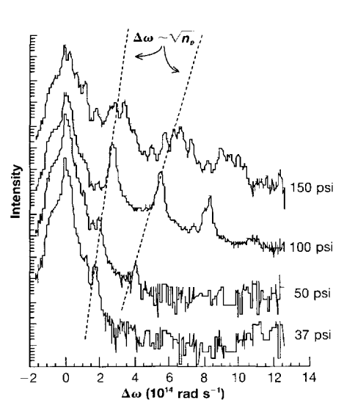
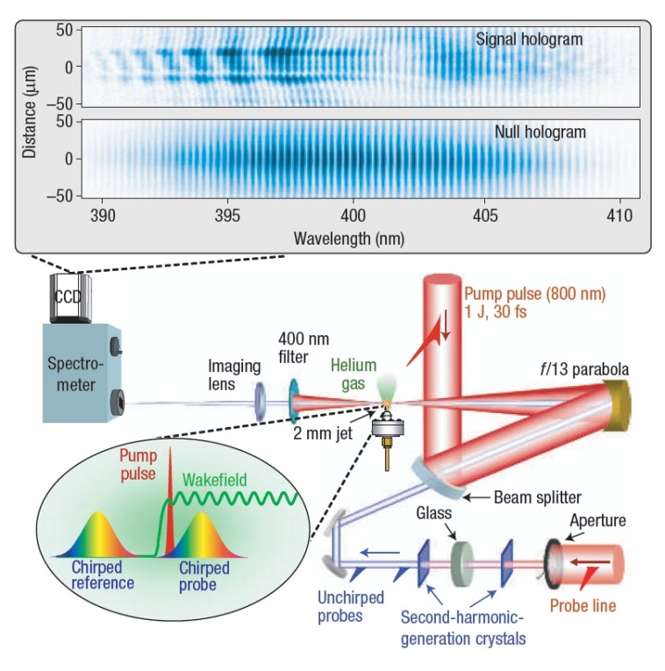
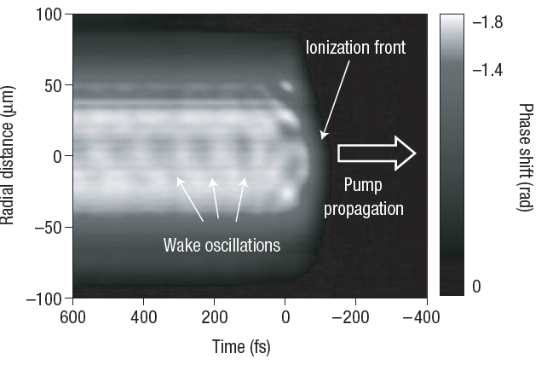
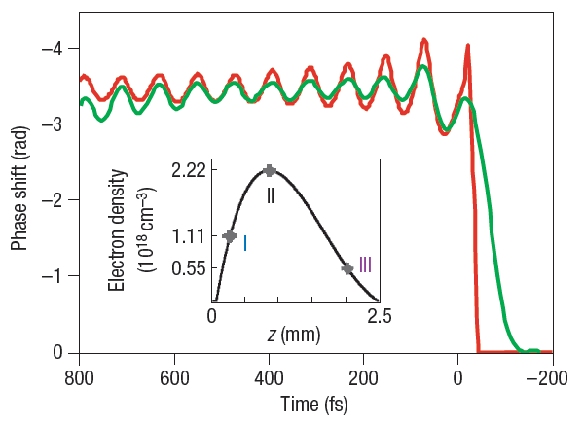
Observation of plasma wave structure
Frequency-domain
(interferometry)holography
Forward Raman scattering
Info about the average
(axially integrated) density
Not really applicable to
short (~λ_{p}) laser pulses
Successful observation of plasma wave
Observation of plasma wave is time integrated
→ No time resolution
Modena et al., Nature 377, 606 (1995)
D. Umstadter et al., Science 273, 472 (1996)
N. H. Matlis et al., Nature Phys. 2,749 (2006)
P. Dong et al., Phys. Rev. Lett. 104, 134801 (2010)

Slide 5
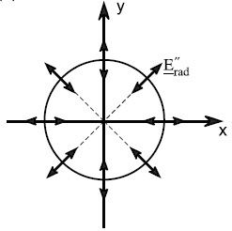
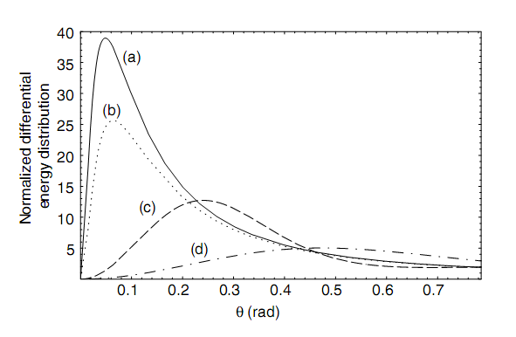
Temporal characterization of electron bunches:
Coherent transition radiation
Transition radiation (TR): radiation when an electron beam traversing a medium with a (dielectric) discontinuity
Transition
radiation
Electron
beam
One electron
radiation spectrum
CTR angular distribution
TR CTR
Form factor: info about
bunch distribution
Hollow cone
θ_{Peak} ~ 1/γ
Coherent transition radiation (CTR):
- larger amplitude than TR
- its wavelength (THz) depends on
inducing electron beam properties
- observed by laser driven electrons
→ Feasible tool to measure bunch duration
W. P. Leemans et al., Phys. Rev. Lett. 91, 074802 (2003)

Slide 6
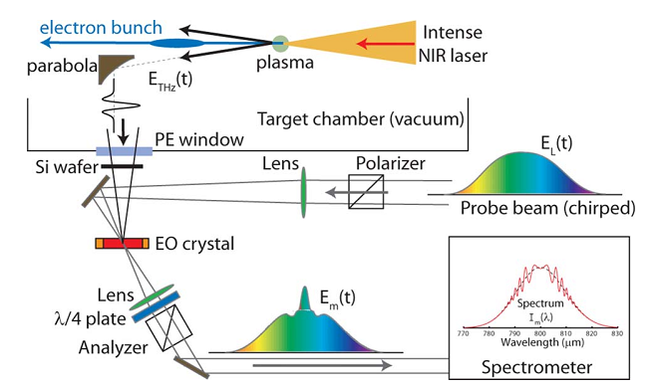
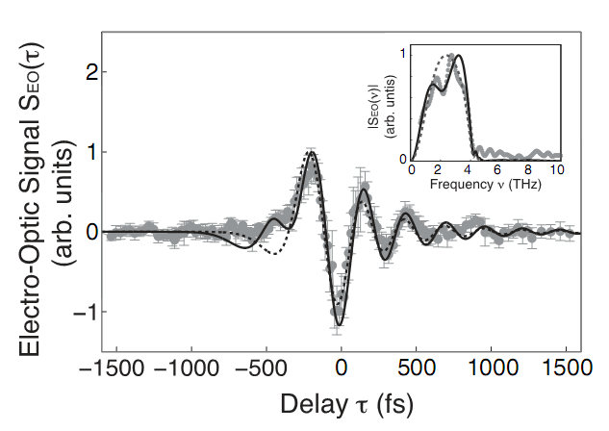
Temporal characterization:
Coherent transition radiation
Electro optic (EO) sampling (1)
to detect THz field (Pockell´s effect)
Single shot versions:
(Enhanced) spectral encoding* (2)
X-correlation (3)
→ 30−100 fs resolution limited bunch duration
Short probe beam
X-correlator (with short probe)
Spectrometer
Detector
Short probe
beam
(1) J. van Tilborg et al., Phys. Rev. Lett. 96, 014801 (2006)
(2) J. van Tilborg et al., Opt. Lett. 33, 1186 (2008)
(3) G. Berden et al., Phys. Rev. Lett. 93, 114802 (2004)
(3) J. van Tilborg et al., Opt. Lett. 32, 313 (2007)
(3) A. D. Debus et al. Phys. Rev. Lett. 104, 084802 (2010)
*Further development: see talk
from J. van Tilborg Thu 11:20

Slide 7
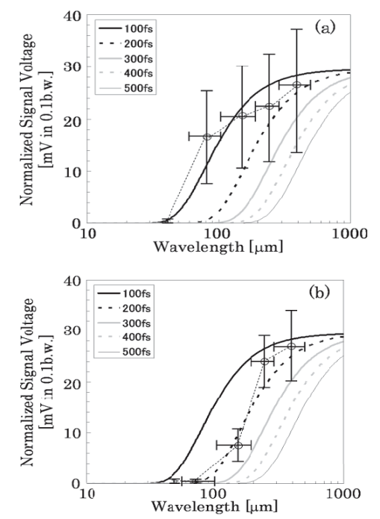
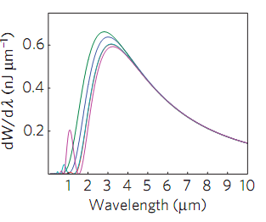
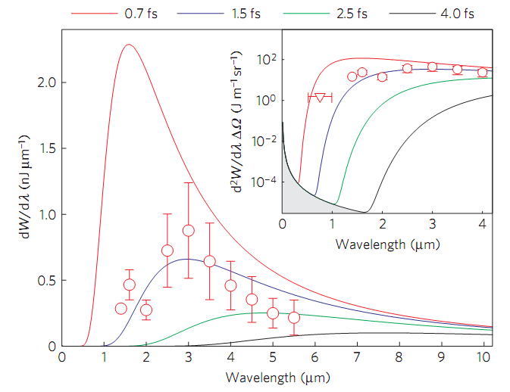
Spectrum of
coherent transition radiation
CTR spectrum
100-250 fs
Okhubo et al.
Peak of CTR spectrum is at
ω_{CTR} τ_{e-} ≈ 1 or λ_{CTR} / (2π) ≈ cτ_{e-}
ω_{CTR ,} λ_{CTR} : CTR circ. frequency, wavelength
τ_{e-} : electron bunch duration (RMS)
1.5 fs (3.5 fs FWHM)
Lundh et al.
Careful THz spectral measurements deliver
also the bunch duration!
→ Indirect measurement after acceleration
T. Ohkubo et al., PRSTAB 10, 031301(2007)
O. Lundh et al., Nature Phys. 7, 219 (2011)
See also talk from S. Karsch Mon 15:45

Slide 8
Observation of
laser plasma acceleration
Potentials of a single-shot, time-resolved technique covering both areas:
Direct measurement and evolution of electron pulse duration
Dynamical evolution of plasma wave amplitude (info about beamloading)
Moment of wave breaking / electron injection

Slide 9
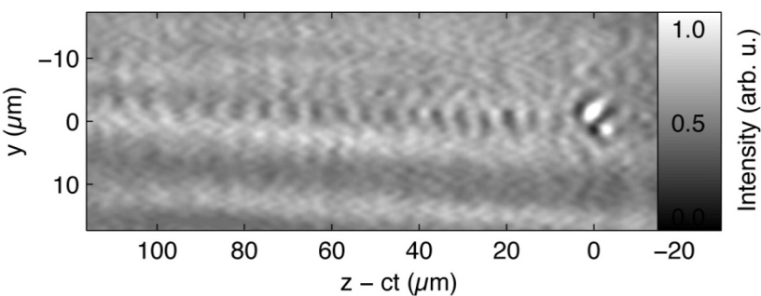
Characterization of the electron bunches
+ direct temporal observation of LWFA
Polarimetry (Faraday rotation) with 8-fs probe
Shadowgraphy with 8-fs probe
Direct observation of laser-
driven electron acceleration with high spatio-temporal resolution
Plasma wave
Electron bunch
A. Buck et al. Nature Phys., 7, 543 (2011)

Slide 10
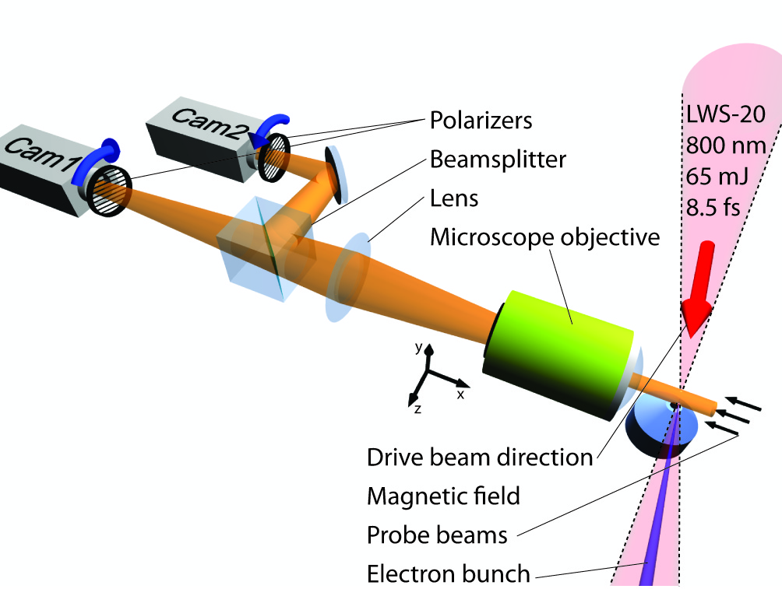
Experimental setup
Visualization of the laser wakefield acceleration with
shadowgraphy &
polarimetry
Requirements:
Good spatial and temporal resolution
Spatial: 2 µm
Temporal: 8.5 fs → 2.6 µm
A. Buck et al. Nature Phys., 7, 543 (2011)

Slide 11
Shadowgraphy
Plasma wave
Electron bunch
Explanation:
Requirements to see plasma wave:
Short probe pulse duration
High-resolution and short depth-of-focus
Conclusions:
Same period
Modulation depth ~ plasma wave amplitude
Pos. of max ~ accel. region
PIC Simulations
+ Ray-tracing
A. Buck et al. Nature Phys., 7, 543 (2011)

Slide 12
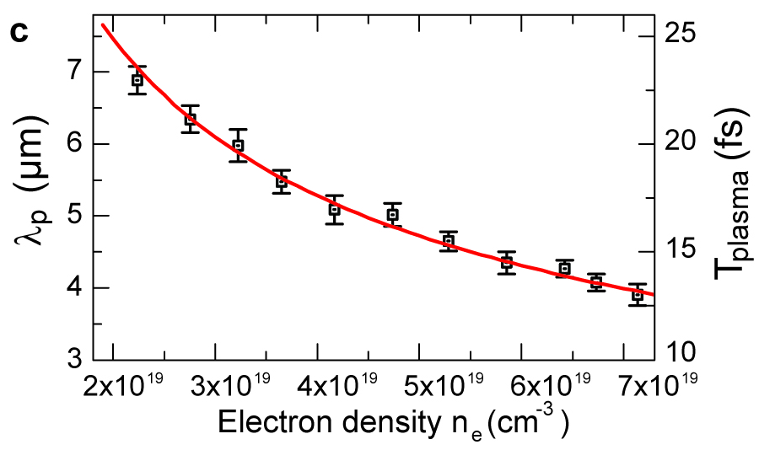
Plasma wavelength
Measurement
Theory
Good agreement with theory.
Another proof that modulation in
fact originates from the plasma
wave
No relativistic effects at a=1.67

Slide 13
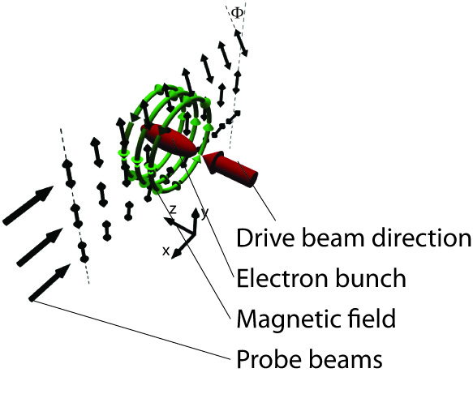
Faraday effect for LWFA
ϕ
Rotation of the laser polarization for linearly polarized probe pulse by the magnetic field
Medium: plasma
Polarization rotation angle:
→ Measure ϕ_{rot} and n_{e} to get B-field distribution!
Measurement of
Location of the electron bunch
Duration of the electron bunch
(if resolution high enough)
Magnetic field → charge

Slide 14
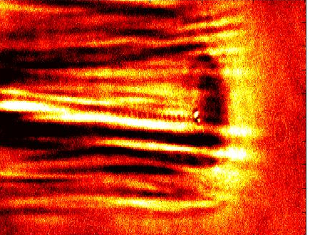
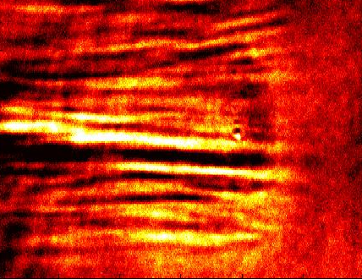
Polarimetry -
Determination of the rotation angle
Detuned
Camera 1
Camera 2
Advantage of detuned polarizers:
Correct background subs.
Sign of magnetic field
Ratio of intensities visualizes the magnetic field of electron bunch
positive
rot. angle
negative
rot. angle
M. Kaluza et al. Phys. Rev. Lett., 105, 115002 (2011),
A. Buck et al. Nature Phys. 7, 543 (2011)

Slide 15
Faraday Rotation Results
Deconvolution of the electron bunch duration
Averaging over 85 shots:
FWHM:
RMS: 2.5 fs
A. Buck et al. Nature Phys., 7, 543 (2011)

Slide 16
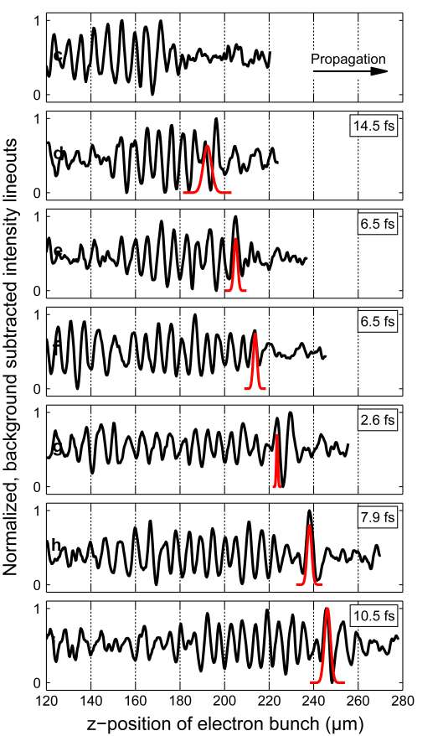
Combined results #1
Real-time observation of electron bunch and plasma wave (by changing the delay between pump and probe pulse)
„Hidden“ details learned about acceleration:
Electron bunch sits in the first oscillation of the plasma wave
Only one electron bunch visible
Many plasma oscillations are visible
No strong beamloading
Notes:
What information can we get when we put both measurements together?

Slide 17
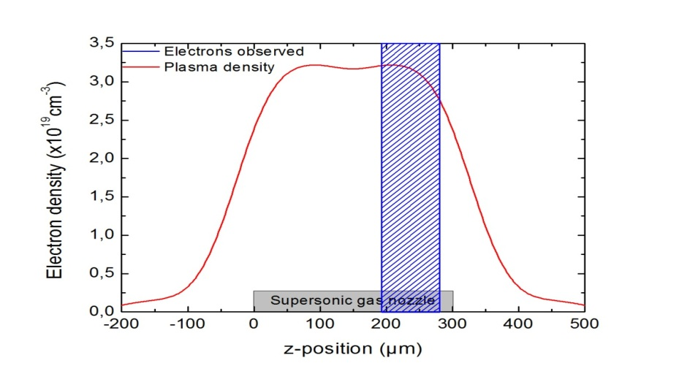
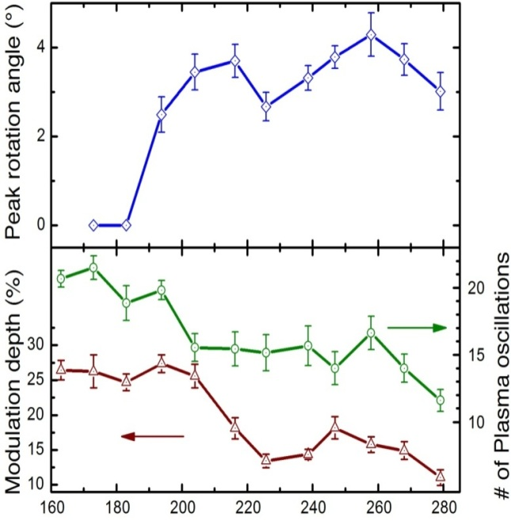
Combined results #2
Laser
Observed dynamics of LWFA:
Injection point at 200 µm from appearance of Faraday signal
Loading of electrons into the plasma wave and start of acceleration (energy flow) Simultaneous decrease of the number of visible plasma oscillations and the amplitude of the plasma wave
No later injection of electrons only
around 200 µm
from constant rotation angle and bunch duration

Slide 18
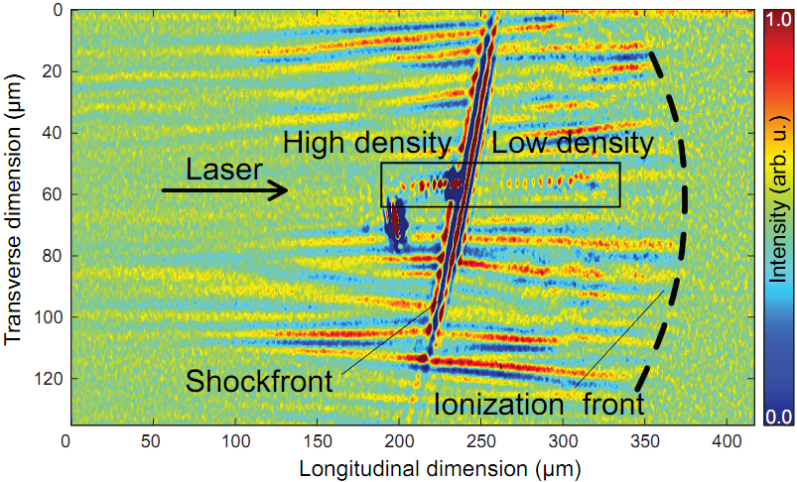
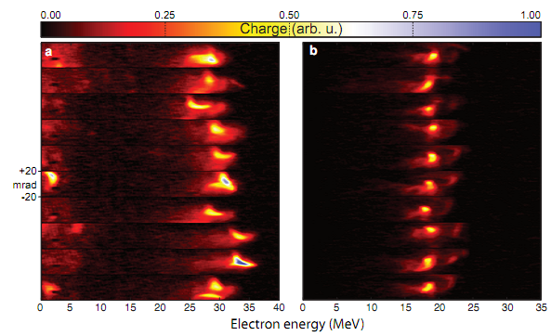
Controlled injection & temporal observation
Self injection
Shock-front injection
0 40
0 40
E(MeV)
Diagnostics are applicable
to other experiments even
with high density gradients
Densities & density jump at shockfront could be measured → 1.7 : 1
Injection stabilized, acceleration
improved
Energy spread significantly
reduced
Tunable electron energy
See talk from A. Gonsalves Tue 9:25

Slide 19
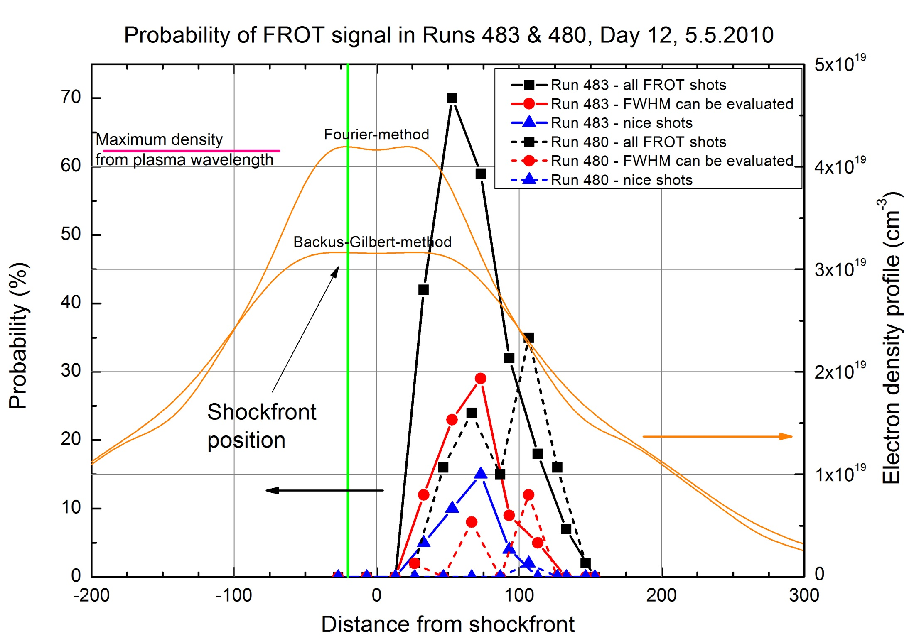
Faraday signal in shock-front injection

Slide 20
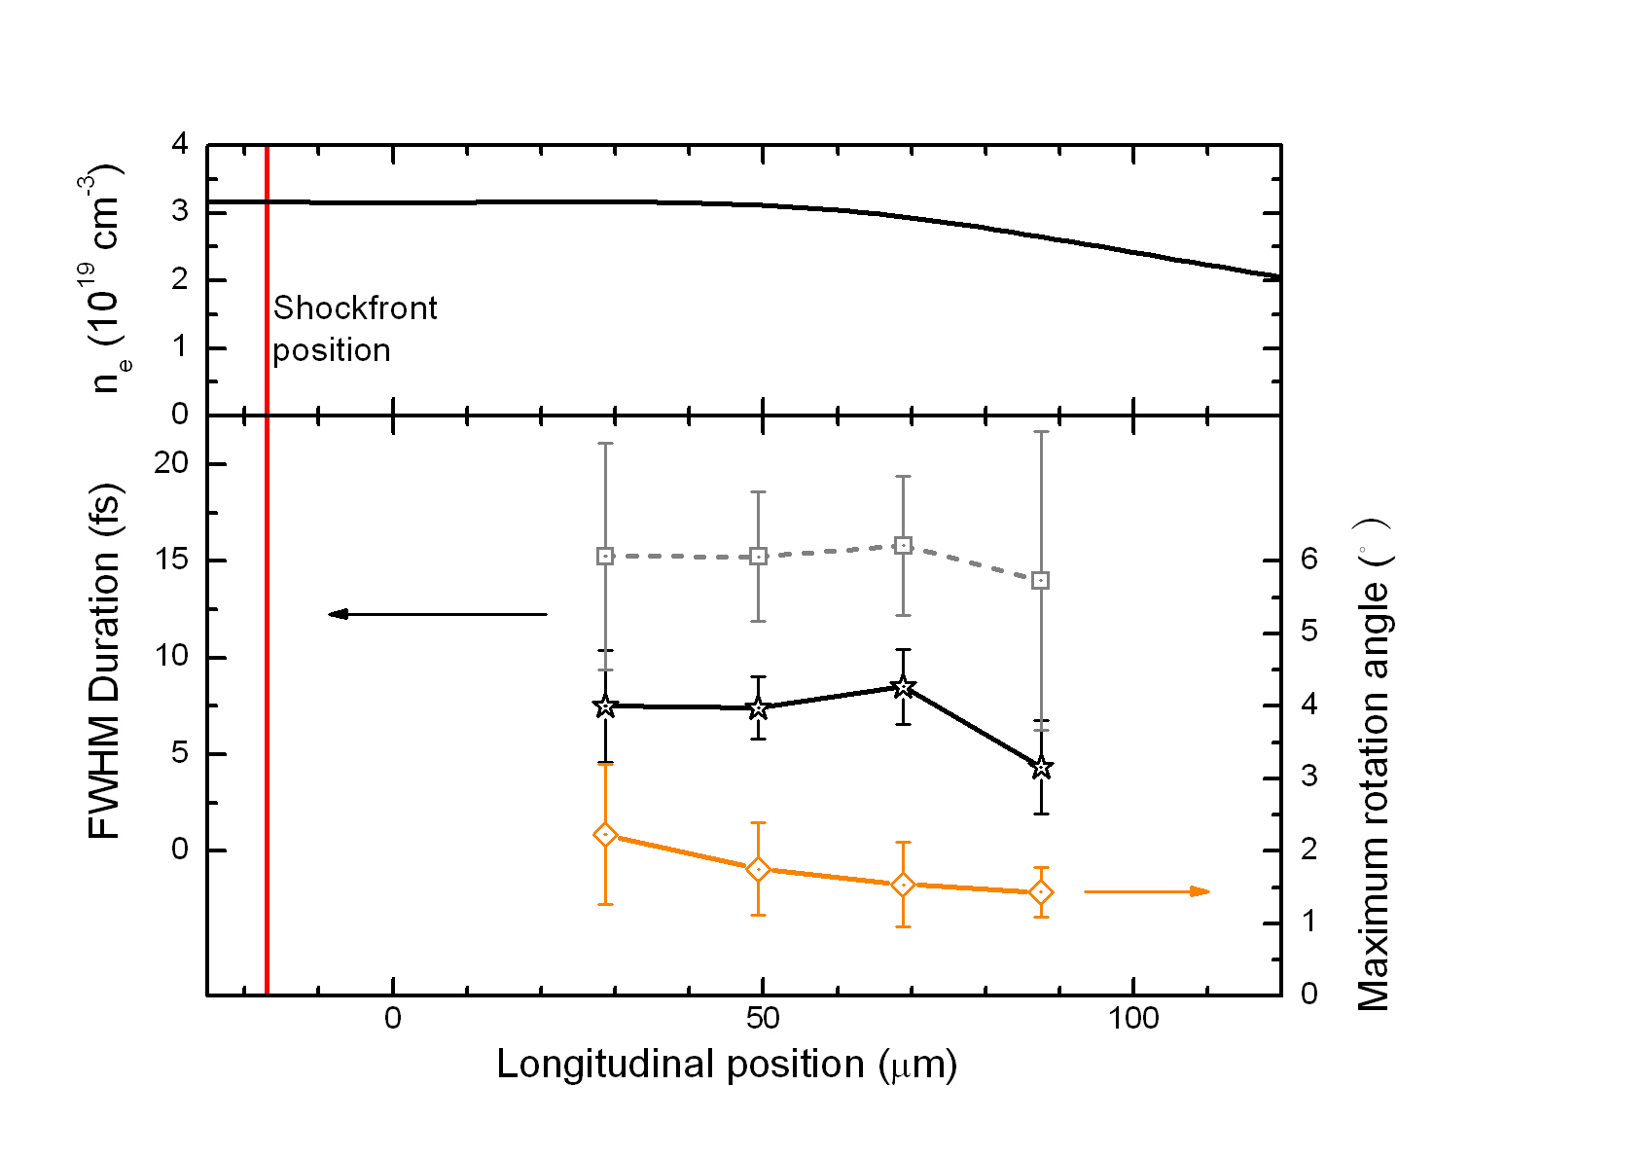
Faraday signal in shock-front injection
Gas density
Measured duration
Deconvolved duration
Conclusions:
In situ plasma wave / density characterization
Injection after shock front (Electron signal observed ~45 µm later)
FWHM deconvolved duration is 6 fs
No significant other dynamics is observed after the injection in ~100 µm acceleration length

Slide 21
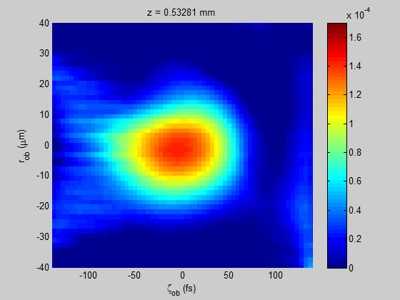
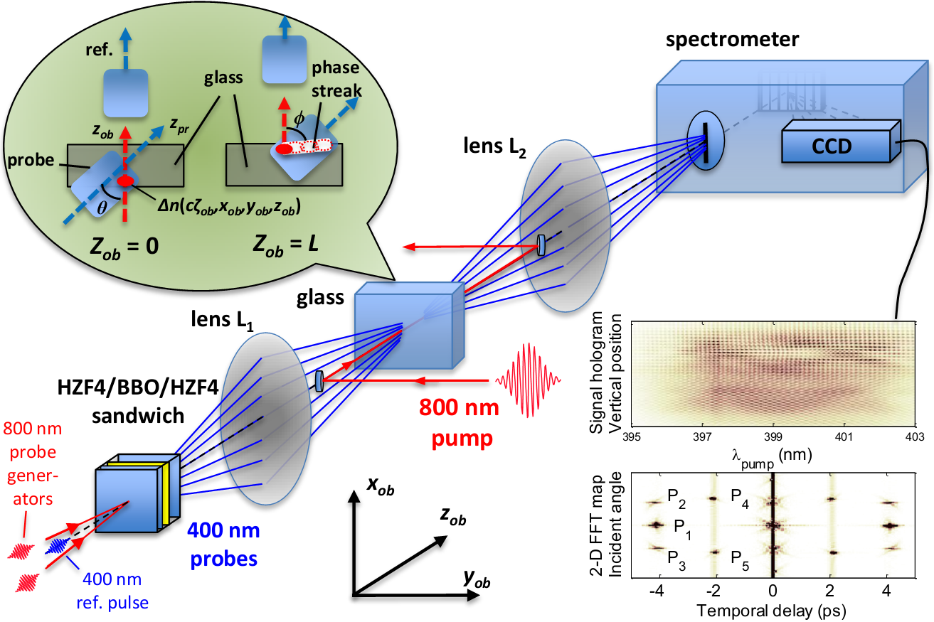
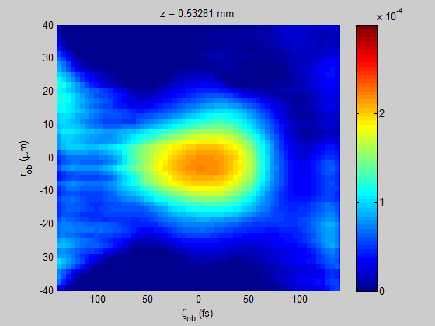
Future directions: single shot movies Frequency-Domain Tomography (FDT)
FDT incorporates index of refraction variation induced phase streaks imprinted on probe profiles at multiple angles and yields a “movie” of evolving index structure in a single shot
E = 500 nJ, index evolution due to nonlinear self-focusing of laser pulse
Compact multi-probe array generation and detection
E = 700 nJ, index evolution due to beam collapse and filamentation
By M. C. Downer group, for details: Z. Li, et al., WG5, Wed 4:15 pm, and student poster WG5-45

Slide 22
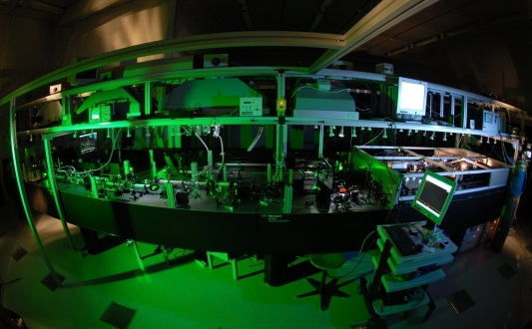
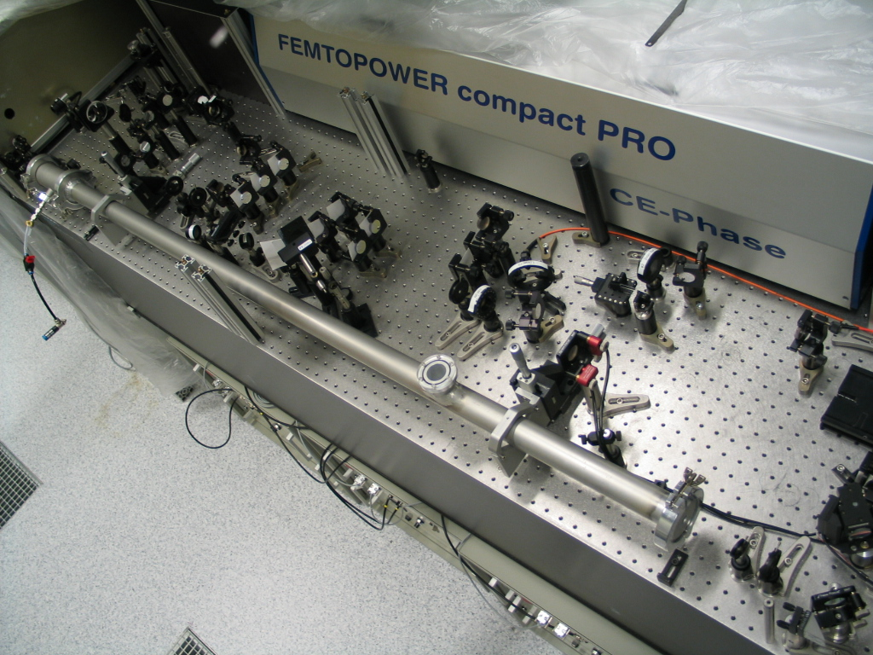
Summary and conclusions
Light Wave Synthesizer 20 with 8 fs pulses is an ideal tool to characterize LWFA
Real-time observation of laser wakefield acceleration (LWFA)
Dynamics of shock-front injection observed
Using few-cycle (sub-10-fs) probe pulses extends the diagnostic capabilities of longer pulse LPA labs
Probe generation in Ti:Sa systems with a (few-)10mJ portion:
Optical parametric amplification
Hollow-core fiber
Hollow Core Fibre

Slide 23
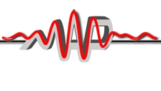
Thank you for your attention !
Acknowledgements:
Munich Center for
Advanced Photonics
Laserlab Europe II
Sonderforschungsbereich Transregio 18
Deutsche Forschungsgemeinschaft

Slide 24
The driver laser: Light Wave Synthesizer 20
Properties :
Most intense few-cycle laser system in the world!
optical parametric chirped pulse amplification
130 mJ / pulse
7.7 - 8.5 fs FWHM pulse duration
16 TW power
10 Hz repetition rate
3 µm / 12 µm FWHM focus diameter (F#3 / F#12 optics)
>10¹⁹ W/cm² / 2.5 x 10¹⁸ W/cm² peak intensity
D. Herrmann et al., Opt. Lett. 34, 16 (2009)

